Slide 1



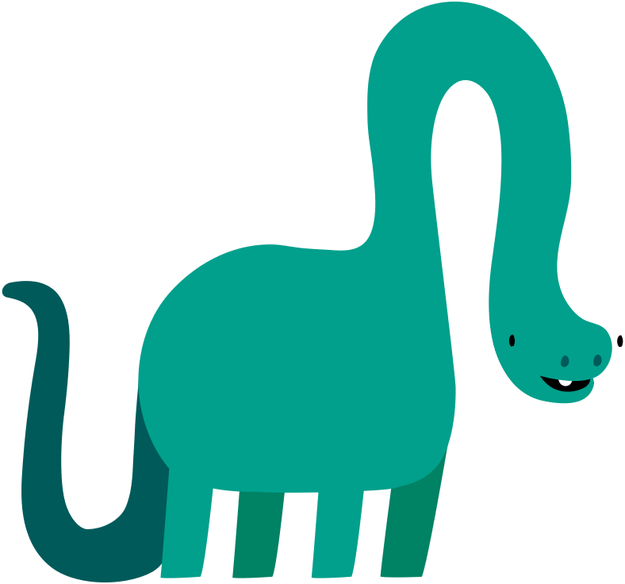
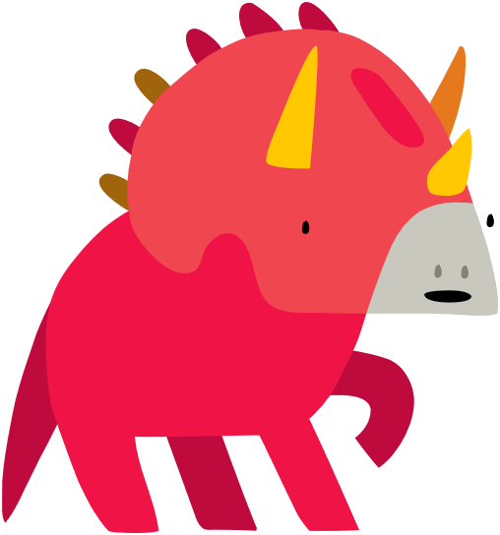
Lesson 7:
Knock, knock!
Knock,
knock!
Who’s
there?

Slide 2
Slide

Slide 3
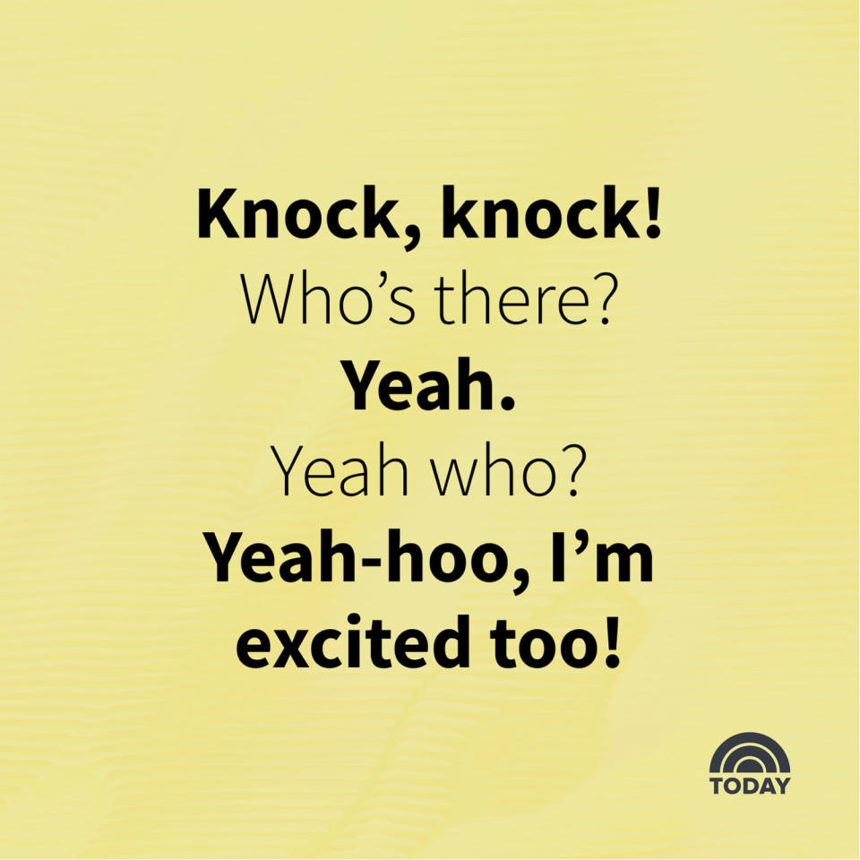
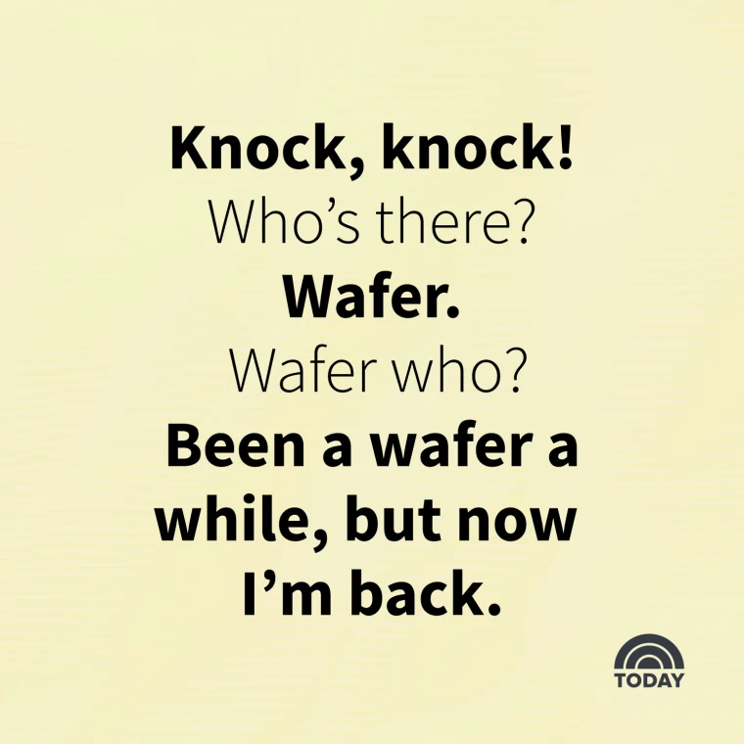
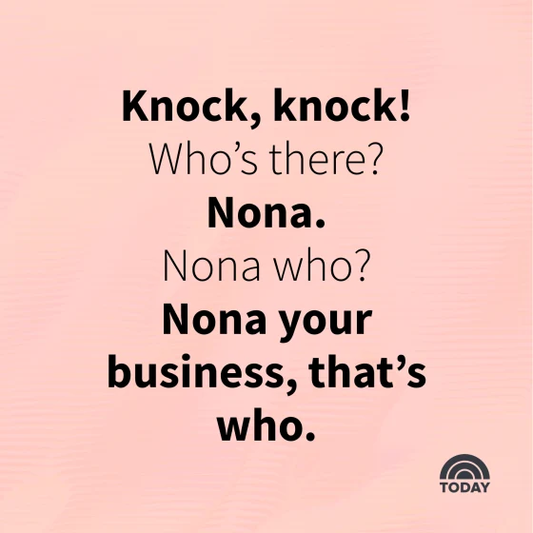
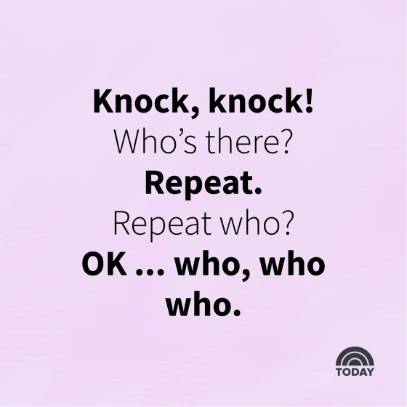
Knock-knock Jokes

Slide 4
Knock-knock Jokes
Place to find more knock-knock jokes:
www.today.com/life/inspiration/knock-knock-jokes-rcna44380

Slide 5


Our Joke
Knock,
knock!
Who’s
there?

Slide 6


Our Joke
Yeah Who?
Yeah!

Slide 7

Our Joke
Yeah-hoo! I’m excited too!

Slide 8


Backdrop

Slide 9
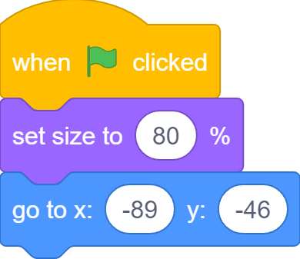
Sprites
First Dinosaur: Dino1

Slide 10
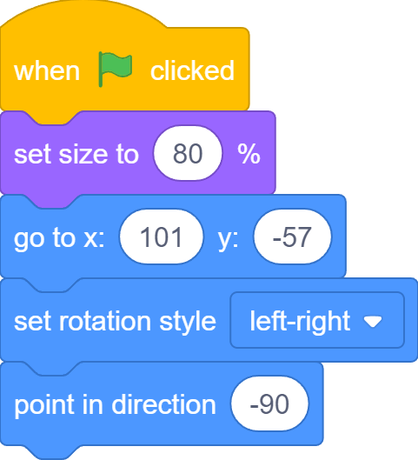
Sprites
Second Dinosaur: Dino2

Slide 11
The Stage is Set!

Slide 12
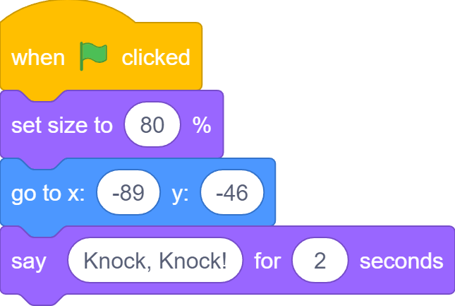
“Knock, knock!”
Knock, knock!

Slide 13
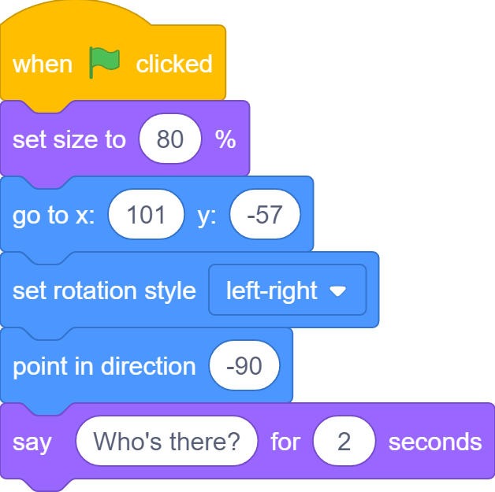
“Who’s there?”
Who’s there?

Slide 14
You’re Speaking Over me!
Knock, knock!
Who’s there?
Dino2 starts to speak before Dino1 has finished!

Slide 15
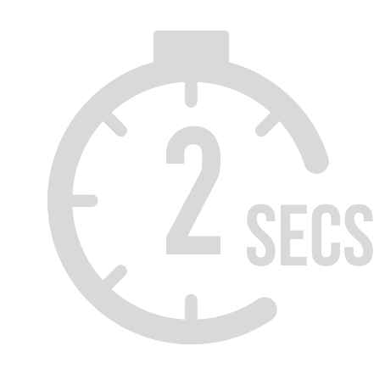
Dino2: Ok, I’ll Wait
Knock, knock!
Who’s there?

Slide 16
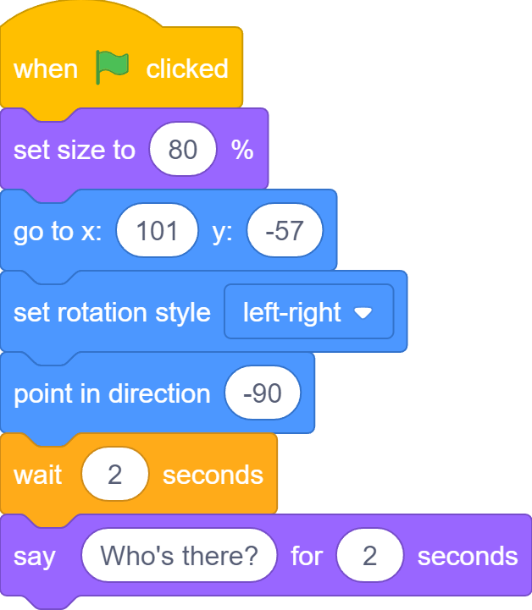
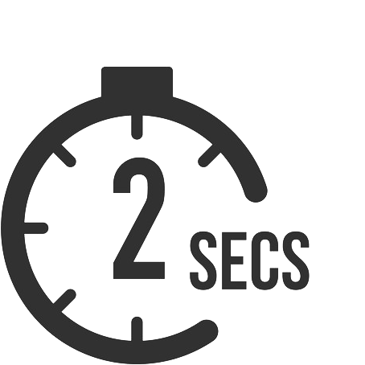
Dino2: Ok, I’ll Wait
Who’s there?

Slide 17
Say-and-Wait
Knock, knock!
Yeah!
Yeah-hoo! I’m excited too!
Time goes this way!
Who’s there?
Yeah who?

Slide 18
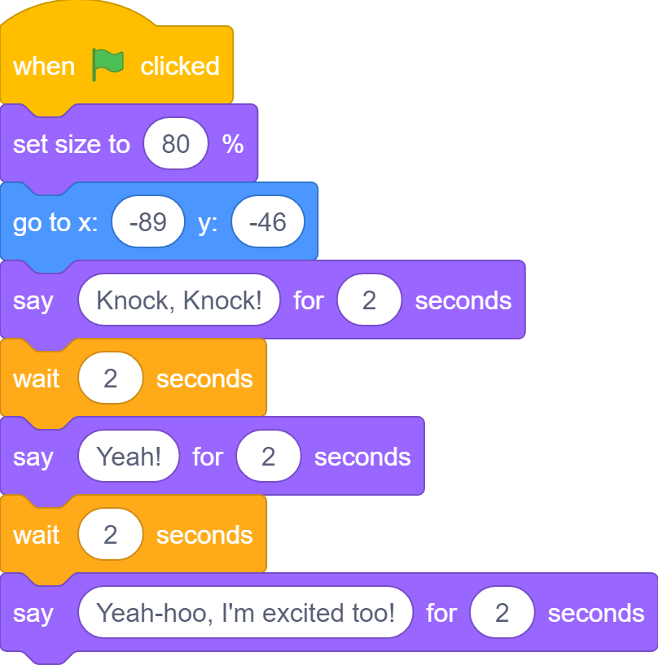
Say-and-Wait

Slide 19
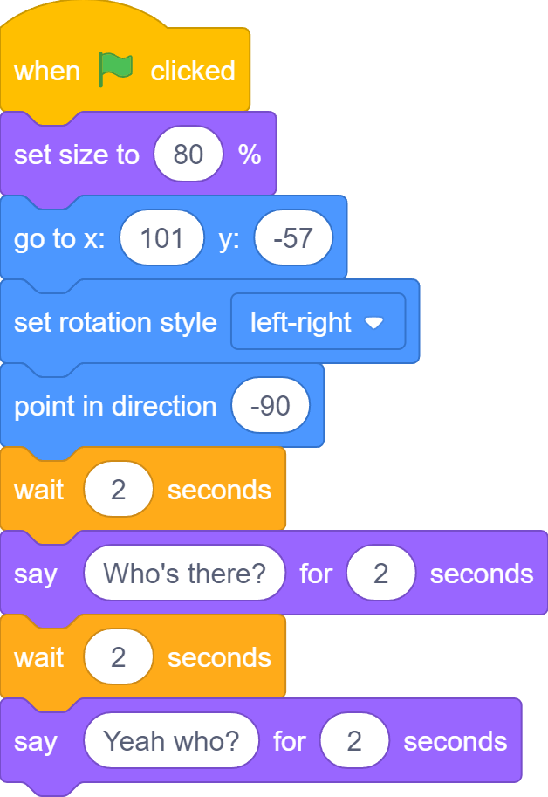
Say-and-Wait

Slide 20

What If…
What if Dino1 changes this from 2 seconds to 4 seconds?

Slide 21

What If…
Dino2 needs to wait from 2 seconds to 4 seconds here

Slide 22
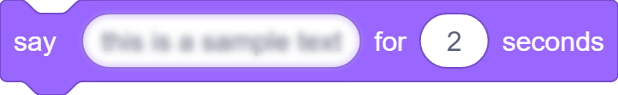
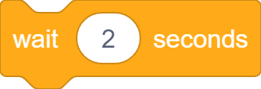

What If…
… in a very long conversation …
… can you easily find which wait block to update in the other sprite?
…
…
… a say block of one sprite changes to 4 seconds …
Sprite1
Sprite2

Slide 23
A More Serious Problem…
What we have with the Say-and-Wait approach is NOT a real conversation at all!
In a real conversation, each side should hear what the other says before replying. But…

Slide 24
A More Serious Problem…
Knock, knock!
Yeah!
Yeah-hoo! I’m excited too!
Time goes this way!
Dino1 can says all its lines even when Dino2 does not exists!

Slide 25
Say-and-Wait
Similarly, Dino2 can says its lines even when Dino1 does not exists!
Time goes this way!
Who’s there?
Yeah who?

Slide 26
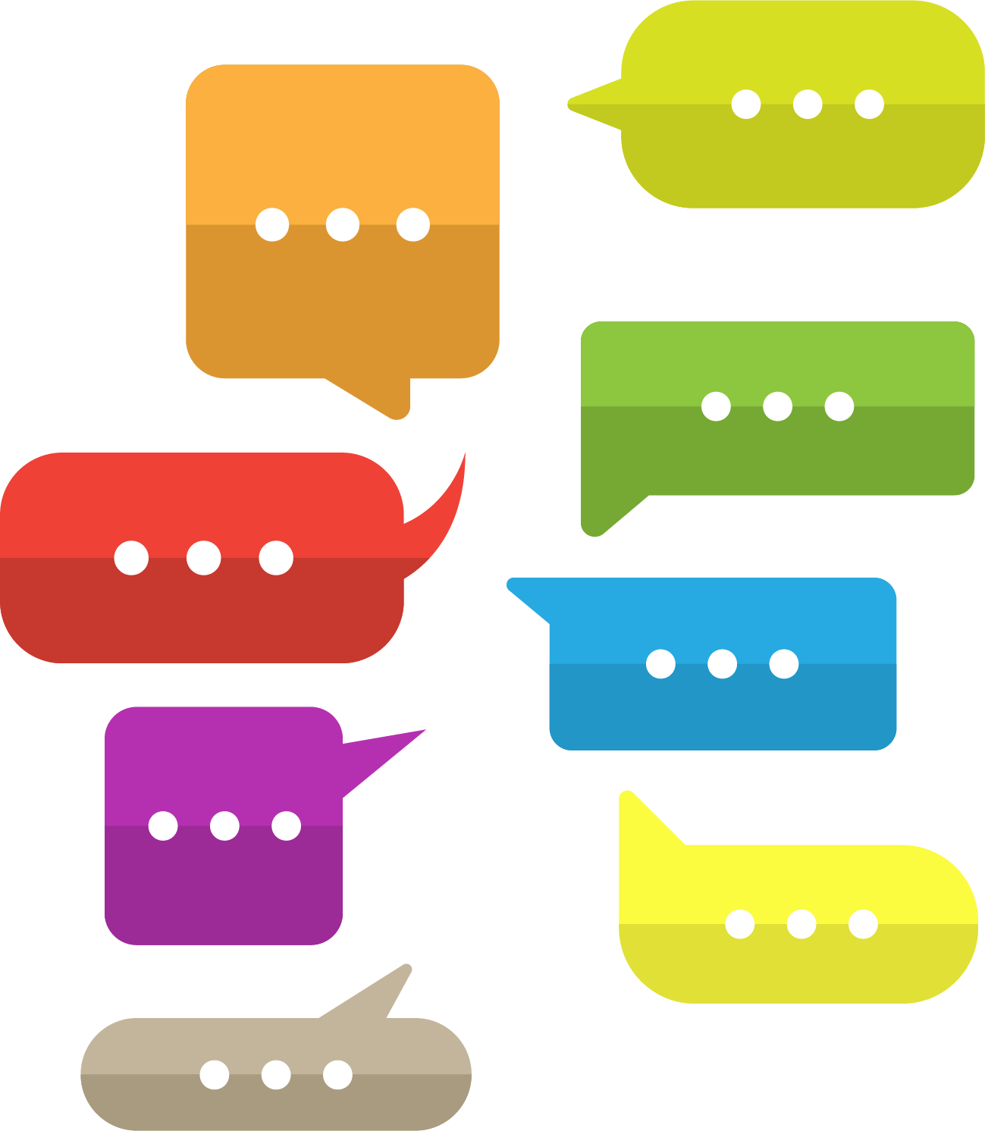


Message Exchange
Any conversation between two sides is essentially message exchanging

Slide 27
Message Exchange
Yeah-hoo! I’m excited too!
Knock, knock!
Yeah!
Who’s there?
Yeah who?

Slide 28


One-to-One

Slide 29
Broadcast

Slide 30

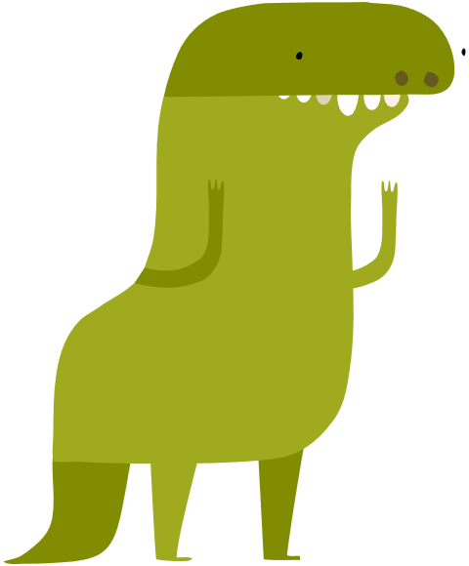
Messages in Scratch are Broadcasted
Assuming we have two more dinosaurs
Knock, knock!
Knock, knock!
Knock, knock!

Slide 31
Slide

Slide 32
Slide

Slide 33

What we learnt…
How to control game character with keyboard keys

Slide 34
Exercises
Can you make the crab to start at a random x position?
Can you add sound effect when turtle reaches ocean?
Can you add sound effect when crab catches turtle?
Can you add more crabs?
Can you make crabs bounce around on the stage instead?
Can you stop all the crab when turtle reaches the ocean?

Slide 35
Thank you and see you in the next lesson!

